Slide 1
Writing an Effective Essay
Notes:
This presentation will help prepare pupils for how to write an effective academic essay. We encourage you to review slides 2-7 with all pupils. You will know your group best, but it may be that KS2 pupils would benefit from reviewing slides 8-11 which introduces them to essay structure and the difference between analysis and description. Key Stage 3 pupils, however, may already have a good understanding of essay structure and thus would benefit from reviewing slides 10-14 with you to explore the difference between analysis and description in more detail.

Slide 2
Which of these would you find in a good essay?
Good spelling, punctuation and grammar
Bullet points
An introduction and conclusion
Copying from other sources
Spelling mistakes and errors
Paragraphs
Clear points that link back to the question
Writing everything you know on the subject
Using research from experts to back up your ideas
Answering the question with a clear opinion
References that show where your information came from
Notes:
This is an optional starter activity to get pupils to think about the academic skills that they have learnt over the programme and how these apply to their final assignment. You can also adapt this to your specific topic. For example – you can ask pupils to reflect on what skills a scientist or writer needs to write a successful essay. You could also ask pupils if they can think of anything else that is missing.
Those without ticks are things to avoid – you can use these as a starting point to discuss what makes a good essay and things to avoid.

Slide 3
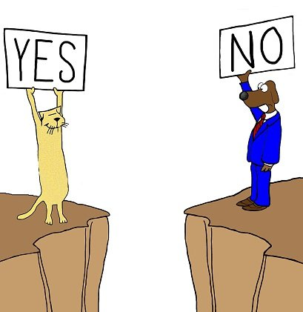
Essays are about arguments
Your essay question or title asks you to express your point of view on the subject.
There is no right or wrong answer.
Your argument must be supported by evidence: statistics, examples, evidence drawn from different sources.
Can you consider other points of view, and show why your argument is the most convincing?
Notes:
The purpose of the final assignment is for pupils to demonstrate their ability to form an academic argument. It is worth mentioning to pupils here that academic arguments are often more complex than a yes or no answer, but that you still want them to make their opinion or ideas about the topic clear.
This should be the focus of the essay. It is not an opportunity to write everything you know on the subject!
It’s not about finding the ‘right’ answer but rather using knowledge and evidence to convince the reader that you are correct.
If you can, consider a different point of view, but show why your argument is the most convincing.

Slide 4
Structuring an essay
What should you include in each part of your essay?
Introduction
Main Body
Conclusion
Bibliography/Reference List
Presentation
Notes:
Task: Pupils to discuss in pairs/small groups the main sections of an essay and what they think they need to include in each part of the essay.
Discussion of this to follow on the next few slides.

Slide 5
Structuring a successful essay
Introduction:
Introduce the topic of your essay – What? When? Who?
Introduce the question you are answering and how you will answer it.
Let the reader know what you will argue. This is sometimes referred to as signposting and helps the reader to know what to expect.
Notes:
Discussion of the key components of an introduction.
Emphasise the importance of focusing on the specifics of the question – not simply writing everything you know on the topic.
You may want to include some examples relevant to your course to illustrate signposting. E.g. This essay will explore 2 case studies and draw on historical research to argue that dogs are the most popular pets in England.

Slide 6
Structuring a successful essay
Main Body:
Each point or section of your argument should use a new paragraph.
Support your ideas with evidence: key facts, examples, statistics and sources that you have explored in your course to prove your point (and remember to reference your evidence!
Analyse evidence using sentence starters like ‘This suggests that…’ or ‘This evidence demonstrates…’
Aim for a balanced argument by considering different points of view.
Link back to the question or title of your essay at the end of each paragraph – make sure you stay focussed on the specific topic.
Notes:
Each section/point of the argument should be self-contained in its own paragraph – this is where planning can help as it enables pupils to break down their ideas into sections before they begin writing.
Each point or section should be supported by evidence – you can relate back to the source analysis session here.
Evidence should be analysed, not simply described or quoted on its own. You may wish to add more sentence starters here.
Encourage pupils to think about other points of view – can they then demonstrate why their own argument is the most convincing?
Each paragraph or section should link directly back to the question in order to maintain the focus of the essay.
We will spend some more time thinking about this, and particularly the difference between description and analysis, later in the session.

Slide 7
Structuring a successful essay
Conclusion:
Summarise the key points made in your essay
Restate your main arguments – be convincing!
References/Bibliography:
Include a list of references to show your reader where you found your evidence
Acknowledge which facts, statistics and ideas are not your own and where you have taken them from (books, articles, newspapers etc.)
Presentation:
Good spelling, punctuation and grammar – proofread to check for errors.
Use the same fonts, spacing and paragraphs.
Notes:
Conclusions should summarise the key points and argument of the essay. This should be a substantial paragraph – there is a tendency for pupils to write very short conclusions but a good rule of thumb is to aim for 10% of the word count.
If you haven’t done so already, you may want to spend time here on the details of referencing and how you expect pupils to do this. For KS2 and 3 pupils, keep the focus on the purpose of referencing and to make sure they know when they need to create a reference and some of the big principles (i.e. author and title), rather than the specific details about where punctuation goes, or the many differences for referencing different types of sources. Referencing will be entirely new to pupils so focus on the big ideas about the importance of referencing when discussing this with them.

Slide 8
Introduction, Main Body or Conclusion – where would each part go?
However, there are many reasons that young people may feel safer with their mobile phones at school. For example, they can get in touch with family members if they need to before or after school. Additionally, an Oxford University study found that using their phones was no worse for teenagers’ mental health than eating potatoes.
This essay explores the idea that mobile phones should be banned in schools. In order to discuss the statement, this essay will present evidence which supports and denies this claim in order to make a balanced judgement based on these findings.
In conclusion, schools could ban mobile phones from being seen in lessons to prevent disruption to lessons, but there is little evidence to support a full ban, as pupils may need mobile phones in certain situations.
One argument to support mobile phones being banned in school is that they can cause disruption to lessons. A survey with a teaching union, NASUWT, estimates that 46% of teachers want mobile phones banned as they cause indiscipline, with some pupils answering phones in lessons or the noise distracting pupils. This figure shows that a large amount of teachers support a ban, but it is not half of all teachers.
Notes:
Ask pupils to read and decide what order the paragraphs should go in.
As an extension task, ask them to think about how each section could be improved.

Slide 9
Introduction, Main Body or Conclusion – where would each part go?
This essay explores the idea that mobile phones should be banned in schools. In order to discuss the statement, this essay will present evidence which supports and denies this claim in order to make a balanced judgement based on these findings.
One argument to support mobile phones being banned in school is that they can cause disruption to lessons. A survey with a teaching union, NASUWT, estimates that 46% of teachers want mobile phones banned as they cause indiscipline, with some pupils answering phones in lessons or the noise distracting pupils. This figure shows that a large amount of teachers support a ban, but it is not half of all teachers.
However, there are many reasons that young people may feel safer with their mobile phones at school. For example, they can get in touch with family members if they need to before or after school. Additionally, an Oxford University study found that using their phones was no worse for teenagers’ mental health than eating potatoes.
In conclusion, schools could ban mobile phones from being seen in lessons to prevent disruption to lessons, but there is little evidence to support a full ban, as pupils may need mobile phones in certain situations.
Notes:
Answer: 2, 4, 1, 3. Highlight that a real essay would be longer.

Slide 10
Analysis and evidence in essay writing
Good essays use evidence to support their argument.
The best essays analyse this evidence – rather than simply describing what the evidence says.
Description = what
Analysis = why? So what? Why is the evidence important?
Notes:
We have referred to the use of evidence and the importance of analysis earlier in this session. This section looks at what these skills mean and how to incorporate this into essay writing.
Good essays use evidence to support their argument. This helps to make your points much more convincing.
To get the best marks, you need to analyse this evidence, not just describe what it says.
Description is the ‘what’ part of your essay.
Analysis is the ‘why’ or the ‘so what?’. This is where you link the evidence to your question and use it to make your argument.
Link back to source analysis session here.

Slide 11
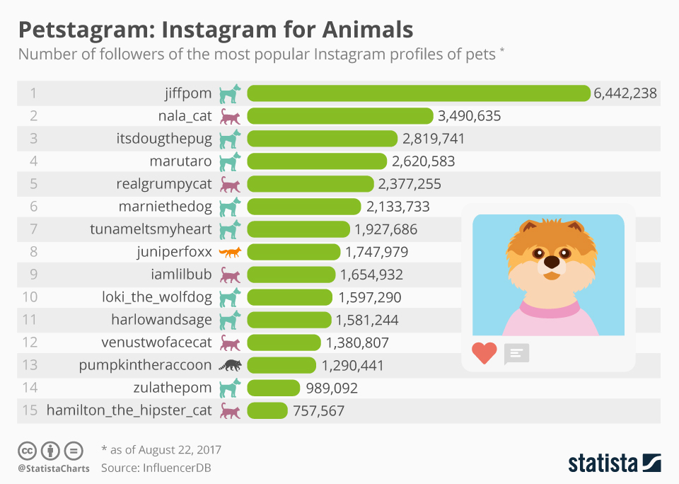
Description vs. analysis
Statistics showing the number of followers of different pet accounts demonstrate that dogs are more popular on Instagram than other types of pet. Of the top 15 pet accounts, 8 are dogs, including 3 of the top 5. In contrast, only 4 of the top 15 accounts relate to cats. There are some unusual animals among the list of dogs and cats such as a fox and a raccoon, suggesting that some people enjoy looking at less typical pets on social media.
The pet with the most followers on Instagram is a dog called jiffpom, with over 6 million followers. This is nearly double the number of followers of the second highest, a cat called nala_cat. There are 13 pet accounts that have over 1 million followers.
Notes:
The first step is to ensure that pupils understand the difference between description and analysis. This has been referred to in earlier parts of the session but the next 2 slides go over this in more detail.
These examples model a descriptive and an analytical paragraph drawn from the source on pets on Instagram. You may wish to replace with a source more relevant to your course.
Ask pupils to read each one and decide which one is descriptive and which is analytical.
Extension: can they identify 2 reasons why the paragraph on the right is analytical?
Key points to draw out:
Descriptive paragraph recites the numbers for different accounts. There is some comparison between the numbers of the top 2 accounts, but no consideration of their significance. On the whole the description simply puts into words what is in the graphic.
Analytical paragraph opens with a clear statement drawn from the statistics that shows the ability to understand and interpret the graphic. It then moves on to consider trends in the evidence, rather than simply stating the order of popularity. There is also a statement regarding contrasts of dog and cat accounts. The comment on the fox and raccoon account shows the ability to spot more unusual features of the statistics, and attempts to consider why these might appear among the list of dogs and cats.

Slide 12
Using analysis in your essay: PEEL
Point – state your point
Evidence – give specific evidence to support your point
Explain – explain how your evidence proves your point
Link – link back to the main point/question of your essay
Notes:
Now we have looked at the difference between description and analysis we can think about how to use this skill in an essay.
The PEEL technique is a way of turning analysis into a paragraph to be used in an essay.

Slide 13
Essay question: Are dogs really man’s best friend?
Point: Many people around the world use social media to follow the lives of dogs.
Evidence: Statistics from Instagram show that the most popular pet account is a dog called ‘Jiffpom’, with over 6 million followers. Of the top 15 pet accounts, 8 are dogs, including 3 of the top 5. In contrast, only 4 of the top 15 accounts relate to cats.
Evaluate: This demonstrates that Instagram users prefer looking at pictures of dogs over those of cats.
Link: This evidence therefore suggests that dogs are the most popular pets and as a result can be considered ‘man’s best friend’.
Notes:
A worked example of PEEL, using the statistics about pets on Instagram.
Together, this would form one paragraph of the essay.

Slide 14
Essay Writing Easy Wins
Prepare an outline or mind map your ideas.
Clear structure.
Analyse, don’t describe!
Use relevant evidence and research to support your points.
Link it back to the question
Notes:
A recap of key things to remember when writing an essay:
Make a plan before you start writing. This will help you make sure that all your points relate to the argument and you can easily move the structure around if you need to.
Remember to use paragraphs. Each point/section of your argument should have its own parapraph, using PEEL.
Analyse don’t describe - Description is for introducing a topic – “what, who, when, where”. Analysis is for examining the evidence and weighing up different ideas. Don’t just copy the relevant research, question whether it supports your point. You can use ‘This may show…’, ‘…because…’, ‘This suggests…’
Use relevant evidence and research to support your points – look back through your course handbook to help you find sources.
Link it back to the question – Ensure each paragraph links back to the question and question yourself ‘am I answering the question?’ ‘Do my arguments link back to the question?’ Don’t just use the essay as an opportunity to write everything you know on the subject!

Slide 15
Tutors to Edit:
We recommend some of the following activities:
Ask pupils to use a paragraph from the essay structuring task on slide 8/9 and identify where the author is using analysis. (lowest challenge)
Use PEEL to discuss the paragraphs from the essay structuring task on slide 8/9. These are broken down into their PEEL components on the following slide
Select one source/piece of evidence from your course. Pupils to discuss in pairs how they could incorporate this into their essay, using PEEL. Alternatively, pairs could each work on a different source and then feed back to the group.
Ask pupils to take a portion of their draft assignment and evaluate what they have done well/what they want to improve when considering PEEL. Then ask them to try re-writing one paragraph, based on this.
Use a final assignment from a previous placement if you have one, or other anonymised sample essay:
select two essays and ask pupils to assess how well they apply the ideas from PEEL in each essay (higher challenge)
ask pupils to use the mark scheme to give feedback on what the final assignment did well, and what they might have done to improve. Pupils should be encouraged to use PEEL to support the feedback they might want to give (highest challenge)
The worksheet summarises key information about this skill to support any task or activity you create
Notes:
Tutor Edits this slide – it is worth noting that pupils most often struggle with moving from description to analysis
You may wish to incorporate more than one of these activities at different points in the presentation, as they do not all have to be concluding activities.

Slide 16
PEEL in practice
This essay explores the idea that mobile phones should be banned in schools. In order to discuss the statement, this essay will present evidence which supports and denies this claim in order to make a balanced judgement based on these findings.
One argument to support mobile phones being banned in school is that they can cause disruption to lessons. A survey with a teaching union, NASUWT, estimates that 46% of teachers want mobile phones banned as they cause indiscipline, with some pupils answering phones in lessons or the noise distracting pupils. This figure shows that a large amount of teachers support a ban, but it is not half of all teachers.
However, there are many reasons that young people may feel safer with their mobile phones at school. For example, they can get in touch with family members if they need to before or after school. Additionally, an Oxford University study found that using their phones was no worse for teenagers’ mental health than eating potatoes.
In conclusion, schools could ban mobile phones from being seen in lessons to prevent disruption to lessons, but there is little evidence to support a full ban, as pupils may need mobile phones in certain situations.
Notes:
Optional additional task to explore PEEL in practice:
Task in pairs: how has this essay used PEEL? Ask pupils to identify where this has been used in the example essay.
Extension: how could this be improved?
Paragraph 2:
Point: Sentence 1: mobile phones cause disruption.
Evidence: NASWT survey with statistic.
Explanation: ‘This figure shows that…’
Link: the final sentence also serves to link back to the question.
Paragraph 3:
Point: Young people may feel safer with mobile phones at school.
Evidence: getting in touch with family (but nt specific evidence here – could be improved with a source or quote)
Evidence: Oxford University study (this does not specifically relate to the point of feeling safer, rather that mobile phones are not detrimental for mental health)
Explanation and Link are missing here – what could be added?

