Slide 1
Giving Brilliant Feedback
02.03.2023 Angie Baker - Teaching and Learning Manager
Get Ready: We’ll be using Slide today, please click on the link in the chat or go to Slido.com, #9290011
Notes:
Tech: Paste link into the chat: https://app.sli.do/event/vyfggFtkToD5AVmtKsmyey

Slide 2
Let’s get started …
Task: Take two minutes to read the student response and the feedback given by two different (fictional) tutors.
You can find the resource in the chat.
Thinking Questions:
Which feedback is the best?
Why?
Be prepared to share your ideas!
Notes:
Which piece of feedback is better –

Slide 3
In today’s session, we will think about …
Theories of Feedback
What makes feedback productive?
Applications of Feedback
Using mark schemes
Flexible and inflexible knowledge
Notes:
Notes: Feedback Poll

Slide 4
Learning Point 1:
Theories of Feedback
What makes feedback productive?
Notes:
Notes: Feedback Poll

Slide 5
Let’s get started …
Task: Take two minutes to read the student response and the feedback given by two different (fictional) tutors.
You can find the resource in the chat.
Thinking Questions:
Which feedback is the best?
Why?
Be prepared to share your ideas!
Notes:
TECH: Paste Slido link into chat: https://app.sli.do/event/vyfggFtkToD5AVmtKsmyey

Slide 6
Which feedback was better?
ⓘ Start presenting to display the poll results on this slide.
Notes:
TECH: Paste Slido link into chat: https://app.sli.do/event/vyfggFtkToD5AVmtKsmyey

Slide 7
What features of feedback B made it better?
ⓘ Start presenting to display the poll results on this slide.
Notes:
TECH: Paste Slido link into chat: https://app.sli.do/event/vyfggFtkToD5AVmtKsmyey

Slide 8
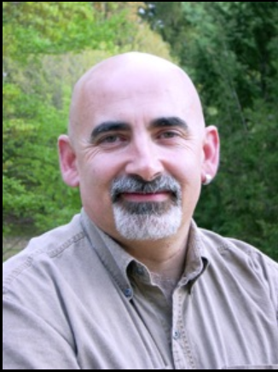
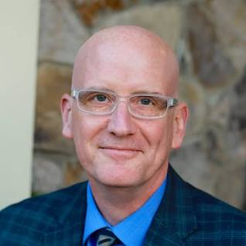
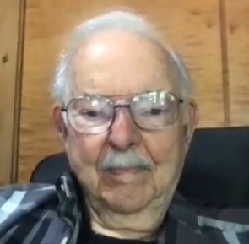
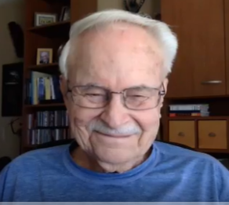
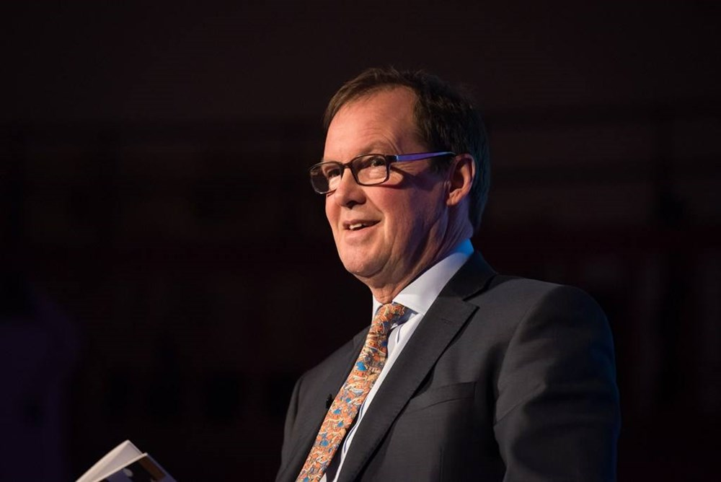
Feedback Thinkers
Dylan Wiliam
Emeritus Professor of Educational Assessment,
University College London
Dan Willingham
Emeritus Professor of Educational Assessment,
University College London
Arthur L. Costa
Emeritus Professor of Education,
California State University
Robert J. Garmston
Emeritus Professor of Educational Adminstration,
California State University
Bill Lucas
Professor of Learning,
University of Winchester

Slide 9
‘The purpose of feedback is to improve the student, not the work that they have just done.’
‘Good teaching starts from where learners are, rather than where we would like them to be.’
Dylan Wiliam
Emeritus Professor of Educational Assessment,
University College London

Slide 10
‘Evaluative feedback makes the smallest contribution to self-directed learning.’
‘Praise … shuts down thinking.’
Arthur L. Costa
Emeritus Professor of Education,
California State University
Robert J. Garmston
Emeritus Professor of Educational Adminstration,
California State University

Slide 11
To retain agency and a sense of individual achievement, feedback should be phrased as ‘might like to’ or ‘could’ rather than ‘must’ or ‘should’.
Bill Lucas
Professor of Learning,
University of Winchester

Slide 12
Before giving feedback, pupils should receive high quality instruction.
Teachers should use formative assessment strategies to check for understanding and to re-teach where necessary.
Feedback should be timely and should focus on moving learning forward, targeting specific learning gaps that pupils exhibit.
Where feedback focuses on learner’s personal characteristics or is vague, it is likely to be less effective.
Teachers should consider HOW to give pupils feedback so that it is welcomed, understood and actioned.
* The guidance report is based on the best available international evidence, in addition to a review of current practice, and refined through consultation with teachers and other experts. (EEF, 2021)

Slide 13
So far, we have thought about …
Theories of Feedback
What makes feedback productive?
What are your key takeaways?
Notes:
Notes: Feedback Poll

Slide 14
What are your key takeaways from this section? What makes feedback productive?
ⓘ Start presenting to display the poll results on this slide.

Slide 15
Learning Point 2:
Applications of Feedback
Using mark schemes
Notes:
Notes: Feedback Poll

Slide 16
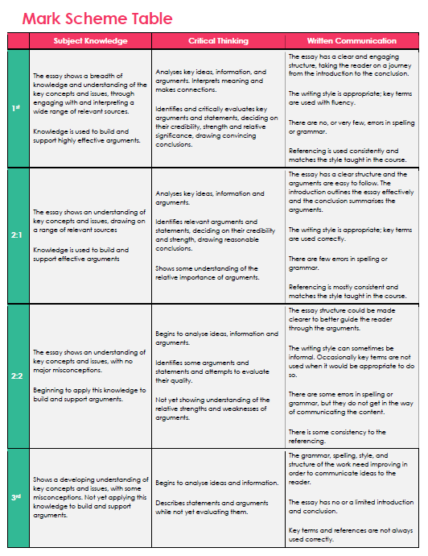
The Brilliant Club
Mark Schemes

Slide 17
Task:
In your break out rooms:
What are the differences between each level?
What two or three words could you use to summarise those differences?

Slide 18
How would you summarise the difference between a 1st and 2:1? What would make it a 1st?
ⓘ Start presenting to display the poll results on this slide.

Slide 19
How would you summarise the difference between a 2:1 and 2:2? What would make it a 2:1?
ⓘ Start presenting to display the poll results on this slide.

Slide 20
How would you summarise the difference between a 2:2 and 3rd? What would make it a 2:2?
ⓘ Start presenting to display the poll results on this slide.

Slide 21
What’s the difference?
1st
Depth and breadth
2:1
Range
2:2
3rd
No major misconceptions
Misconceptions
Criticality and relative significance to argument
Flowing argument
Clarity of argument
Conclusions drawn from evidence
Uses arguments
Own argument not completely clear
Mainly descriptive
No clear argument

Slide 22
So far, we have thought about …
Theories of Feedback
What makes feedback productive?
Applications of Feedback
Using mark schemes
What are your key takeaways?
Notes:
Notes: Feedback Poll

Slide 23
What are your key takeaways from this section? How can we use the mark scheme?
ⓘ Start presenting to display the poll results on this slide.

Slide 24
Learning Point 3:
Applications of Feedback
Flexible and inflexible knowledge
Notes:
Notes: Feedback Poll

Slide 25
‘When knowledge transfers, that means they will have successful applied old knowledge to a new problem.’
Dan Willingham
Emeritus Professor of Educational Assessment,
University College London
Notes:
Dan Willingham talks a lot about knowledge transfer. There are lot of different that are used for similar things here. Flexible knowledge, deep knowledge, understanding of deep structures are interchangeable in this regard.
Essentially, what he argues is that in order for knowledge to be purposeful, exciting, deep, we need to be able to understand it and apply it in new contexts.
Shallow, surface or inflexible knowledge refers to stuff that we understand in context but we can’t apply it elsewhere. For example, a student might understand that in order to protect a castle from attack, we need to put defense mechanisms in place, soldiers, a moat etc but not be able to apply that same logic to preventing a nuclear attack on a country, or … to take it to a completely new context, to protect a particular organ in the body being attacked by cancer cells.
It’s important for us as educators to help pupils begin to move their knowledge from one context to another – so, to give them concrete examples of how this knowledge transfers. We do this, within subject specialisms by providing lots of examples and lots of application process – where pupils are asked to apply knowledge to new contexts. This could be to a different case study, to a different experiment, to a different source text. We might ask a question like: If we know that in order to protect a castle, we need to put in defense mechanisms close by that either hinder the attackers ability to get to the castle, or attack the attacker whilst it is on its way, how could be apply that same strategy to a nuclear threat? Notice that it’s really important to make the connection out loud, to verbalise our expert questioning and thinking.

Slide 26
The Scholars Programme
Formative feedback – in tutorial Q&A, Homework feedback, The Hub
Formative:
Opportunity to affect inflexible knowledge
Summative????
Opportunity to affect flexible knowledge

Slide 27
Our Mission:
We mobilise the PhD community to support students who are less advantaged to access the most competitive universities and succeed when they get there.

Slide 28
What’s the best thing to feedback on?
Subject Knowledge
Critical Thinking
Written Communication
T1-5?
T6?
T7?

Slide 29
What feedback? When?
Tutorial 6
Clear up misconceptions
Model criticality
Tutorial 7
Transferability
Structure of arguments
Model clarity, structure and flow
Most significant knowledge (and it’s deep structure)

Slide 30
So far, we have thought about …
Theories of Feedback
What makes feedback productive?
Applications of Feedback
Using mark schemes
Flexible and inflexible knowledge
What are your key takeaways?
Notes:
Notes: Feedback Poll

Slide 31
What are your key takeaways from this section? How can we use our understanding of flexible and inflexible knowledge to help us to provide the right feedback at the right time?
ⓘ Start presenting to display the poll results on this slide.

Slide 32
Today’s Takeaways
Productive Feedback
Meets learners where they are
Is tentative
Mark Schemes
Use your summary words to place
Give feedback with the next summary words in mind
Types of Knowledge
Ask what is the purpose of this feedback
Feedback accordingly
Improves the student, not the piece of work

Slide 33
References:
Wallace, I. and Kirkman, L. (2017) Feedback (Best of the Best Series), Crown House Publishing
Willingham, D. (2009). Why Don’t Students Like School? Jossey Bass.

